Slide 1
Layouts and Orientation
CS235AM
Android App Development
by Brian Bird
Winter 2018
Lane Community College

Slide 2
Course Schedule
Wk | Topic
1 | Intro + single-screen apps
2 | Multi-screen (multi-activity) apps
3 | Activity lifecycle + state
4 | Adapting to size and orientation: Layouts
5 | Fragments
Wk | Topic
6 | List View
7 | Managing data: SQLite
8 | Geolocation
9 | Publishing to an App Store
10 | Term Project

Slide 3
Android UI Layouts
A Layout is a container that provides a way to arrange the location of UI controls (widgets)
All layout classes inherit from the ViewGroup class
Layouts can be nested
Layouts can be specified in AXML or programmatically

Slide 4


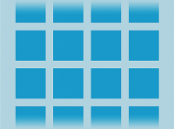

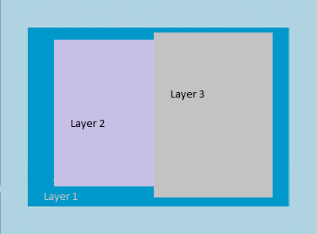
Types of Layouts
Linear Layout
Relative Layout
Table
Grid
Frame
Notes:
Linear Layout
http://developer.android.com/guide/topics/ui/layout/linear.html
https://developer.xamarin.com/guides/android/user_interface/linear_layout/
Relative Layout
http://developer.android.com/guide/topics/ui/layout/relative.html
https://developer.xamarin.com/guides/android/user_interface/relative_layout/
Table Layout
http://developer.android.com/guide/topics/ui/layout/grid.html
https://developer.xamarin.com/guides/android/user_interface/table_layout/
Grid Layout
https://developer.xamarin.com/guides/android/user_interface/gridlayout/
http://developer.android.com/reference/android/widget/GridLayout.html
Contrstaint Layoutou
https://developer.android.com/training/constraint-layout/

Slide 5
Linear Layout
Two possible linear layout orientations:
Horizontal: Widgets are stacked side-by-side
Vertical: Widgets are stacked one above or below another

Slide 6
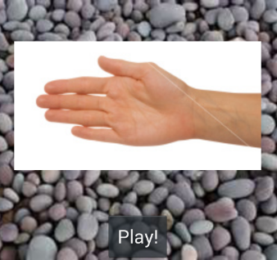
Linear Layout Orientation
Horizontal and Vertical Orientations
Nested Linear Layouts
<LinearLayout android:orientation="vertical" android:layout_width="fill_parent" android:layout_height="fill_parent"> <ImageView android:tag=”Details omitted" /> <Button android:tag=”Details omitted" /> </LinearLayout>

Slide 7
Common LinearLayout Attributes
orientation
weight
gravity

Slide 8

A horizontal layout where the buttons have no weight
The orientation attribute for the layout:
android:orientation="horizontal"

Slide 9
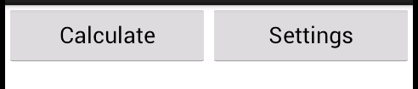
A horizontal layout where the buttons have equal weight
weight attribute for both buttons: android:layout_weight="1"

Slide 10
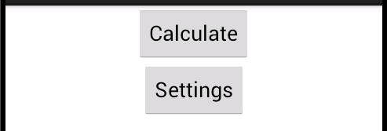
A vertical layout with buttons centered horizontally
The gravity attribute for both buttons: android:gravity="center"
This an attribute of the LinearLayout, not the Button

Slide 11
gravity vs. layout_gravity
gravity attribute
Determines how the items contained by this item will be positioned.
https://developer.android.com/reference/android/widget/LinearLayout.html#attr_android:gravity
layout_gravity attribute
Tells it’s parent how this item should be positioned.
https://developer.android.com/reference/android/widget/LinearLayout.LayoutParams.html#attr_android:layout_gravity

Slide 12
Relative Layout
The position of widgets is relative to the layout or to other widgets
Eliminates the need for nested layouts (better performance)

Slide 13
Positioning in a Relative Layout
Some of the available widget properties:
layout_alignTop – Aligns the top of this widget with the layout
layout_centerVertical – Centers this widget in the layout
layout below – Positions the top edge of this view below another widget

Slide 14
Layout Designer – Position
Position relative to other widgets
When you first drag a widget out of the toolbox, drop it so that it touches the widget that you want it to be below
Notes:
https://docs.microsoft.com/en-us/xamarin/android/user-interface/android-designer/designer-basics?tabs=vswin#margin

Slide 15
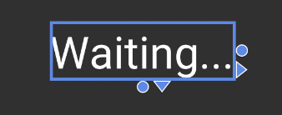
Layout Designer – Size
Adjusting Size
The first time you click a widget, size handles appear
Drag the circular handles to adjust the size
Click on the arrow handles to fill the parent in that direction
Notes:
https://docs.microsoft.com/en-us/xamarin/android/user-interface/android-designer/designer-basics?tabs=vswin#margin

Slide 16
Layout Designer – Margins
Adjusting Widget Margins
The second time you click a widget, margin handles appear
Drag the handles to adjust the margin
Notes:
https://docs.microsoft.com/en-us/xamarin/android/user-interface/android-designer/designer-basics?tabs=vswin#margin

Slide 17
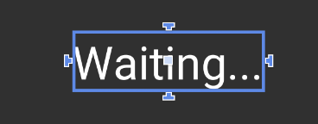
Layout Designer – Alignment
Aligning Position
The third time you click a widget, alignment handles appear
Drag a handle to an edge of another widget to align it’s relative position
Notes:
https://docs.microsoft.com/en-us/xamarin/android/user-interface/android-designer/designer-basics?tabs=vswin#margin

Slide 18
Changing Layouts for Orientation

Slide 19
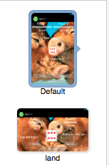
Folder Names Identify the Layout
Portrait
Default orientation
Folder name: layout or layout-port
Landscape
Folder name: layout-land

Slide 20
Location of the XML Files
Portrait Resources/layout/activity_main.xml
Landscape Resources/layout-land/activity_main.xml

